Slide 1
DFA Generator and validator using Python
Group Members:
Sahil Nenwani 9870
Hamza Abbasi 9847
Wahab Shahid 9878

Slide 2
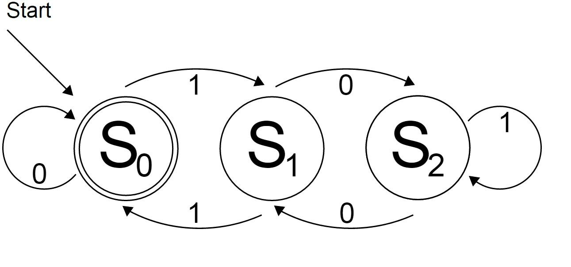
What is DFA
In DFA, for each input symbol, one can determine the state to which the machine will move. Hence, it is called Deterministic Automaton

Slide 3
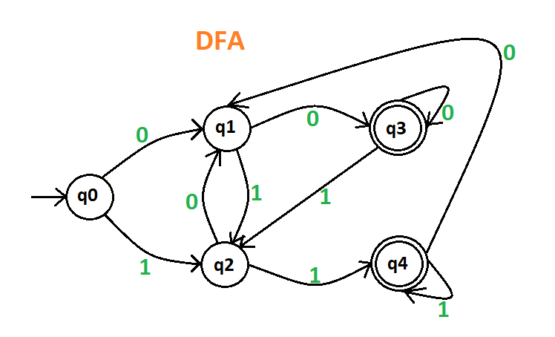
1st Example
Basic DFA has five states, There is one initial state and two final states with two input symbols.

Slide 4
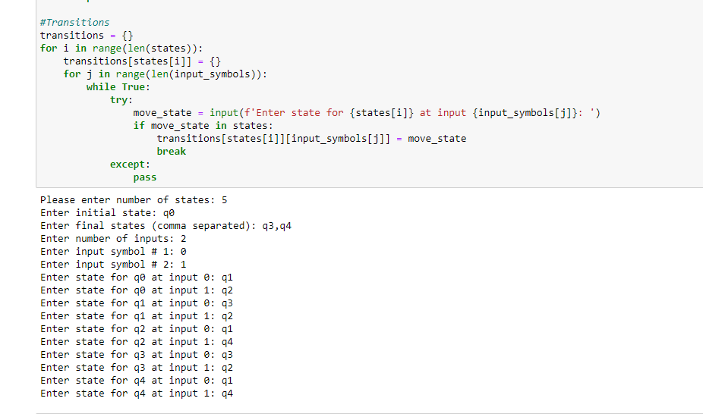
Sample DFA
Taken 5 states
Initial state q0
Final states q3,q4
Input symbols are {0,1}

Slide 5
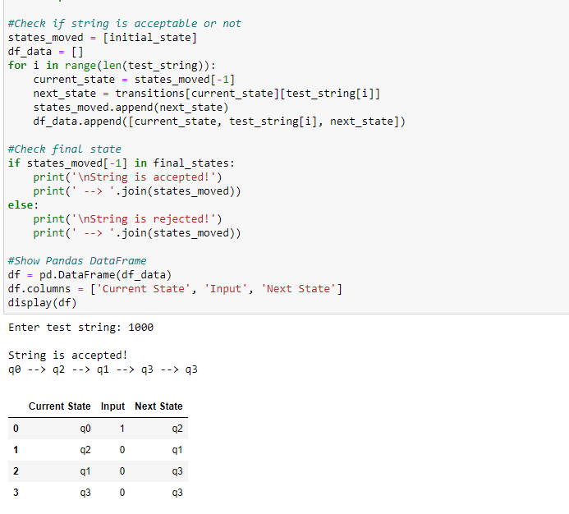
Case 1
1000 is accepted

Slide 6
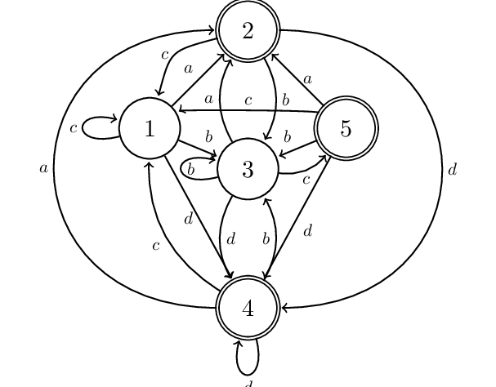
2nd Example
Medium DFA has 5 states,
There is one initial state and three final states with four input symbols.

Slide 7
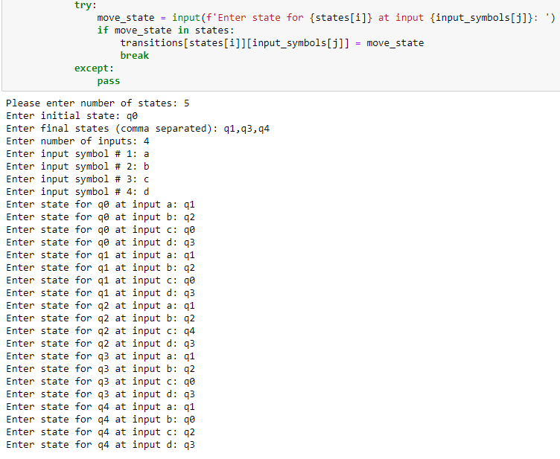
DFA
Taken 5 states
Initial state q0
Final states q1,q3,q4
Input symbols are {a,b,c,d}

Slide 8
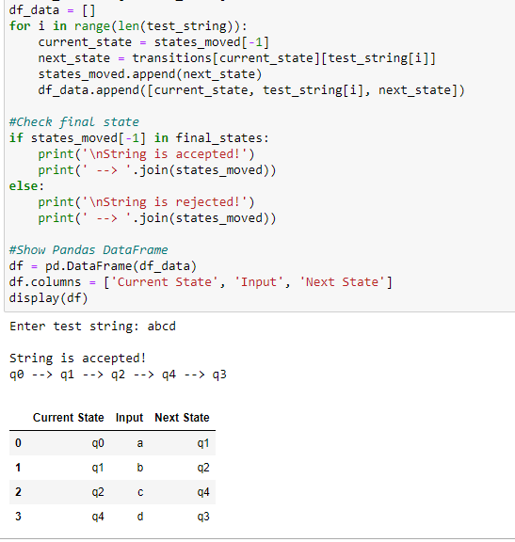
Case1
abcd

Slide 9


